Slide 1

TAX REFORM 2025-2026
GST 2.0
New Provisions, Amendments & Budget 2026
Comprehensive Analysis with Landmark Sahil Enterprises Case Study
April 2026
56th GST Council Meeting

Slide 2
PRESENTATION OVERVIEW
Table of Contents
01
Introduction to GST 2.0
02
New Rate Structure & Provisions
Transformative reforms from 56th GST Council Meeting
Four-slab framework and key provisions
03
Key Amendments 2026
04
Budget 2026 Highlights
Critical changes effective April 1, 2026
GST and business compliance changes
05
Compliance Changes
06
Sahil Enterprises Case
Hard validations and portal updates
Landmark judgment on ITC rights
07
Business Implications
Action points and strategic recommendations for navigating GST 2.0

Slide 3
OVERVIEW
Introduction to GST 2.0
56th GST Council Meeting
Prime Minister's Vision
September 3, 2025: The most significant overhaul of India's GST framework since its inception in 2017. The meeting, held in New Delhi after a six-month hiatus, addressed long-standing agenda points and approved comprehensive reforms.
"Next-Generation GST reforms announced on August 15, 2025, during the 79th Independence Day celebration."
— Narendra Modi, Prime Minister of India
8 Years
Sept 22
Since GST Implementation
Effective Date (Most Changes)
Reform Objectives
Simplify tax structure with fewer slabs
Enhance compliance through technology
Key Stakeholders
Reduce classification disputes
Create business-friendly environment
Union Finance Minister (Chair)
State Finance Ministers
Union Territories Representatives

Slide 4
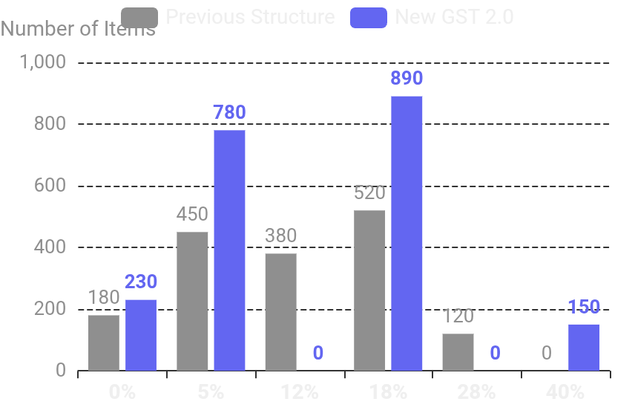
RATE RATIONALIZATION
GST 2.0: New Four-Slab Rate Structure
Previous vs. New Structure
0%
Essential Goods
5%
Common Goods
Dairy products
Packaged food
33 lifesaving drugs
Toothpaste, soap
Educational materials
Shampoo, hair oil
School books
Bicycles
Food grains
Economy air tickets
18%
Standard Rate
40%
Demerit Goods
Consumer electronics
Premium cars
Key Changes
Compact cars
Motorcycles (350cc+)
12% slab abolished
28% slab replaced
Restaurant dining
Aerated beverages
Processed foods
Online gaming
40% demerit rate
Cess eliminated
Manufactured goods
Betting & gambling

Slide 5
MAJOR REFORMS
Key New Provisions Under GST 2.0
Intermediary Services Reclassification
Insurance GST Exemption
E-Commerce Simplification
Previous Rule:
Major Relief:
Simplified Registration:
Place of supply was supplier's location (India) → Taxable at 18%
Both life insurance and health insurance are now exempt from GST, making essential protection more affordable for citizens.
Streamlined GST registration process for small sellers operating through e-commerce platforms.
New Rule:
Place of supply is recipient's location → Treated as export of service
Reduced premium costs for policyholders
Reduced documentation
Increased insurance penetration
Faster approval process
Social security enhancement
Lower compliance burden
No GST on services to overseas clients
ITC available on inputs
Beneficiaries: IT/ITES, consulting firms, marketing agencies, BPOs
Impact: Significant cost savings for middle-class families
Benefit: MSMEs can easily join digital marketplace
Automated Refund System
GST Tribunal
90% Provisional Refunds
No Minimum Threshold
GSTAT Operational
For exporters and inverted duty structure cases from Nov 1, 2025
Export refunds processed regardless of amount
Accepting appeals from Sept 30, 2025
Improved Cash Flow
Hearings Begin
Risk-Based Processing
Critical for small exporters using postal/courier
December 31, 2025
System-generated analysis for faster processing
Backlog Deadline
June 30, 2026

Slide 6
APRIL 1, 2026
Amendments Effective from April 1, 2026
1
LUT Filing for FY 2026-27
2
Export Refund Threshold Removed
3
New Invoice Series
Requirement:
Previous Rule:
Requirement:
File new Letter of Undertaking before generating first export invoice from April 1, 2026
Refund applications below ₹1,000 were not processed
Start fresh document series from April 1, 2026 for invoices, debit notes, and credit notes
New Rule:
Consequence of Non-Compliance:
Every valid refund claim, regardless of amount, will now be processed
Common Error:
Must pay IGST on exports and claim refund later → Cash flow disruption
Continuing previous year's series → Reconciliation problems in GSTR-1
Small claims no longer ignored
Form: RFD-11
Improved cash flow for small exporters
Action: Update TALLY ERP/invoicing software before April 1
File via GST Portal → Services → Refunds → Furnish LUT
4
E-Invoice Compliance
5
ECRS Negative Balance
6
GTA Forward Charge
New Threshold:
System:
Requirement:
Mandatory for AATO exceeding ₹5 crore in FY 2025-26
Electronic Credit Reversal and Reclaimed Statement tracks ITC reversals and reclaims
Obtain written declaration from GTA for FY 2026-27 if they opt for forward charge
30-Day Limit:
Warning:
Without Declaration:
For taxpayers with AATO ₹10 crore+
Negative closing balance currently triggers warning → May block return filing
Reverse charge liability shifts to recipient
Penalty: Invoices reported after 30 days are invalid for ITC
Action: Verify GTA declarations before April 1, 2026
Action: Update ECRS with accurate document-level data now

Slide 7
UNION BUDGET 2026-27
Budget 2026: GST & Business Compliance Changes
Section 15 & 34 Amendment
Section 54 Amendments
Change:
Section 54(6)
Section 54(14)
No pre-existing agreement required for post-sale discounts
Provisional refunds for inverted duty structure
Minimum threshold removed for export refunds
Improved cash flow
All claims processed
New Rule:
Credit note under Section 34 + ITC reversal by recipient = Discount excluded from taxable value
Section 101A(1A) - Interim Appellate
Issue:
Resolves long-standing disputes on post-sale discounts
National Appellate Authority for Advance Rulings (NAAAR) not yet constituted
Solution:
Section 13 of IGST Act
Government can authorize existing authority/tribunal to hear appeals under Section 101B
Change:
Effective from April 1, 2026
Special rule for intermediary services removed
"Yuva Shakti-driven, execution-focused" - shifting from policy intent to system-level delivery
New Rule:
Place of supply determined by general rule (recipient's location)
Budget Theme:
Reduces disputes and improves export clarity

Slide 8
JANUARY 2026 ONWARDS
Compliance & Portal Changes: Hard Validations
GSTR-3B Filing Restrictions
ITC Reconciliation - Now Critical
Hard Validation Introduced
Monthly Reconciliation Required:
GSTR-3B filing blocked when ITC reported doesn't match eligible balances in GSTR-2B
Between GSTR-2A (dynamic) and GSTR-2B (static, cut-off based)
Business-Critical Process:
Previous System:
Not merely good practice - essential for filing
Mismatches generated warnings but didn't prevent filing
Ensure purchase invoices in GSTR-2B before claiming ITC
Impact: Non-reconciled returns cannot be submitted
Follow up with suppliers for timely invoice reporting
IMS Action Points
Penalties for Non-Compliance
Credit Notes:
Late Fees
Interest
When reporting credit note in GSTR-1, communicate with customer immediately
₹50/day (₹25 CGST + ₹25 SGST)
18% p.a. on unpaid tax
Rejected Credit Notes:
ITC Loss
Suspension
Create additional GSTR-3B liability for recipient
Cannot claim pending ITC
GST registration may be suspended
Action: Check all credit notes rejected by vendors - reduce ITC and take corrective action
Recommendation:
Implement automated alerts for GSTR-2B mismatches at least one week before filing deadlines

Slide 9
LANDMARK JUDGMENT
Case Study: M/s. Sahil Enterprises vs. Union of India
Case Details
The Issue
Case Number
Date of Judgment
Supplier's Non-Compliance:
WP(C) No. 688 of 2022
January 6, 2026
M/s. Sentu Dey filed GSTR-1 returns showing sales to petitioner but filed nil GSTR-3B returns, failing to deposit collected GST
Court
High Court of Tripura
Department's Action:
• Blocked petitioner's Electronic Credit Ledger
Judges
• Issued Show Cause Notice under Section 73
Hon'ble Chief Justice M.S. Ramachandra Rao & Hon'ble Justice S. Datta Purkayastha
• Confirmed demand of ₹1.11 crore with interest & penalty
Key Point:
Section 73 invoked (not Section 74) - meaning no allegation of fraud against petitioner
About the Petitioner
M/s. Sahil Enterprises
Constitutional Challenge
Proprietary concern engaged in trading of rubber products
Section 16(2)(c) of CGST Act:
"No registered person shall be entitled to the credit of any input tax... unless the tax charged... has been actually paid to the Government"
Transaction Period:
July 2017 to January 2019
Petitioner's Challenge:
GST Paid:
Provision violates Articles 14, 19(1)(g), 265, and 300-A of the Constitution
₹1,11,60,830
To supplier M/s. Sentu Dey

Slide 10

JUDGMENT ANALYSIS
Sahil Enterprises: Court's Key Findings & Ruling
Court's Critical Observations
The Ruling
1
No Mechanism for Verification
"Reading Down" Doctrine Applied
Purchaser has no statutory mechanism to verify whether supplier has filed correct GSTR-3B returns and deposited tax
Section 16(2)(c) must be read down to apply only to:
• Non-bona fide transactions
• Collusive transactions
2
Impossible Burden
• Fraudulent transactions to defraud revenue
Imposing obligation on purchaser to verify supplier's compliance requires them to "do the impossible"
Constitutional Validity Upheld
Arbitrary Classification
Section 16(2)(c) is not violative of Articles 14, 19(1)(g), 265, or 300-A
3
Section 16(2)(c) fails to distinguish between bona fide purchasers and collusive/fraudulent transactions
Double Taxation
Final Order
4
Denying ITC to purchaser who already paid GST to supplier amounts to double taxation, violating Article 265
Demand Order Set Aside
Order dated May 17, 2022 quashed
ITC Restored
₹1,11,60,830
Directed to be allowed to petitioner
A purchaser cannot be expected to perform the impossible, and denial of ITC in respect of genuine transactions would be arbitrary and unjust.

Slide 11
STRATEGIC RECOMMENDATIONS
Business Implications & Action Points
System Upgrades
Vendor Management
Compliance Actions
Update ERP & Billing Systems to reflect new GST rates (0%, 5%, 18%, 40%)
Establish Vendor Compliance Policy - ensure key suppliers file returns on time
File LUT for FY 2026-27 before first export invoice (Form RFD-11)
Implement Automated Reconciliation for GSTR-2B before filing GSTR-3B
Monthly Vendor Reconciliation - verify GSTR-1 vs GSTR-3B filing
Start New Invoice Series from April 1, 2026
Configure E-Invoice Systems for 7-day reporting requirement
GTA Declarations - obtain written declarations for FY 2026-27
Update ECRS with accurate document-level data
Timeline: Before April 1, 2026
Benefit: Avoid ITC disallowance
Critical: Avoid filing blocks
Training & Process Enhancement
Monitor & Adapt
Finance Team Training on new GST rules, hard validations, and reconciliation procedures
Implement Compliance Calendar to track all GST deadlines and avoid penalties
Regular Compliance Audits to identify gaps proactively
Engage GST Professionals for complex compliance matters and litigation support
Stay Updated on notifications, circulars, and case laws
Set Up Automated Alerts for GSTR-2B mismatches one week before filing deadlines
Goal: Proactive compliance

Slide 12

CONCLUSION
Navigating GST 2.0:
The Path Forward
The GST reforms of 2025-2026 represent a paradigm shift toward a simplified, technology-driven, and compliance-focused tax ecosystem.
While the transition requires significant system upgrades and process changes, businesses that adapt early will benefit from streamlined operations, reduced litigation, and improved cash flows.
The Sahil Enterprises judgment reinforces the principle that bona fide taxpayers deserve protection - a welcome relief for honest businesses.
Proactive Compliance
Technology Adoption
Continuous Learning
Stay ahead of regulatory changes
Leverage automation and AI
Stay informed on case laws
Success lies in preparation, adaptation, and informed decision-making

